Slide 1

“Civics 101”
Class #3
Tom Tresser
October 7, 2022
Notes:
Music “Na Na Na” My Chemical Romance, by suggested by Anthony - https://www.youtube.com/watch?v=egG7fiE89IU

Slide 2
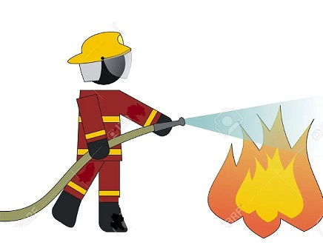
“Putting Out The Fire” Assignment – Due 4th Class – October 12th
Notes:
Instructions for your final project “Putting Out the Fire – Addressing my Burning Issue” -> https://tinyurl.com/C51-Assignment
Time for check-ins – anyone need any brainstorming help?

Slide 3



What is civic engagement?
Domain 1 – Civic Heart – What is your disposition?
Domain 2 – Civic Brain - What stuff should you know?
Domain 3 – Civic Muscle - What should you be able to do?
Notes:
Repeat the 3 domains.

Slide 4
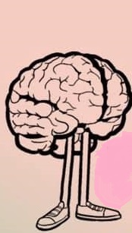
What should be IN our Civic Brain?

Slide 5

Know Your History
Kahlil Greene – The Gen Z Historian
First Black president of Yale student body
71,300+ Instagram followers
578,500+ Tik Tok followers
“You don’t necessarily grow up thinking you’re going to be the first person to do anything in this world, but if you work hard and you dream big, it can and will happen.”

Slide 6
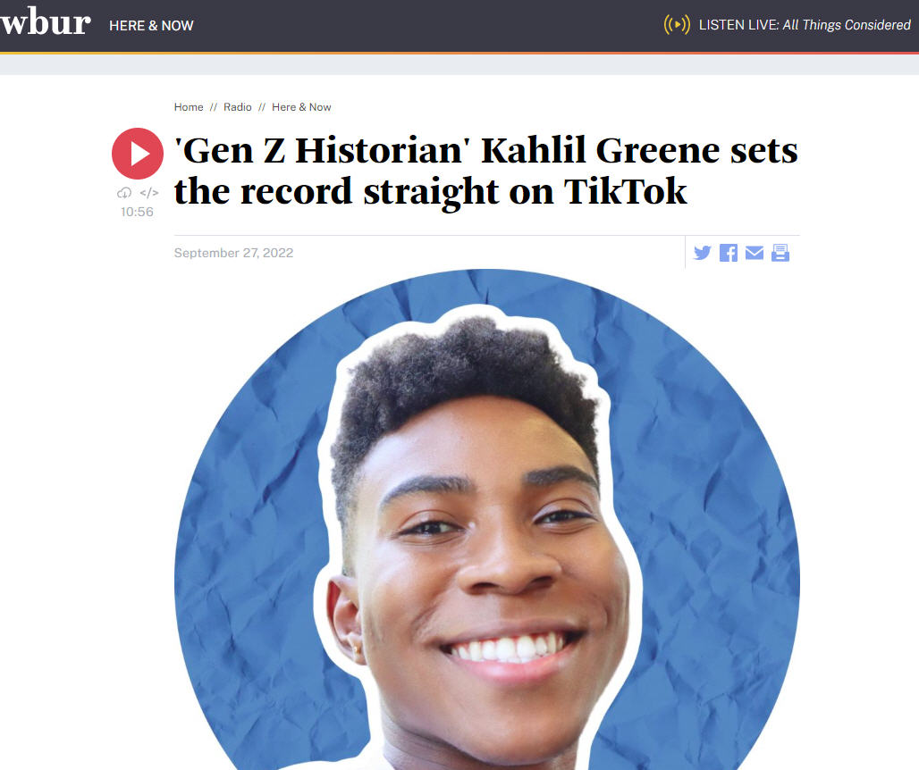
Know Your History
Notes:
https://www.wbur.org/hereandnow/2022/09/27/gen-z-historian-kahlil-greene (11 minutes)

Slide 7


Slide 8

Use JamBoard for your group
Please post first names of your group
on your JamBoard
What Activities &
What Sources to
upgrade our
comprehension
of history/context?
Notes:
How can we build our Civic History/Context comprehension?
Use the JamBoard at http://www.tinyurl.com/C51-History – each group has its own. Go to Use the JamBoard for your Group #. Put first names on a PostIt note.
We will take 10 minutes for this.

Slide 9

Report Back
Notes:
2 minutes per group

Slide 10

Notes:
5 minutes

Slide 11
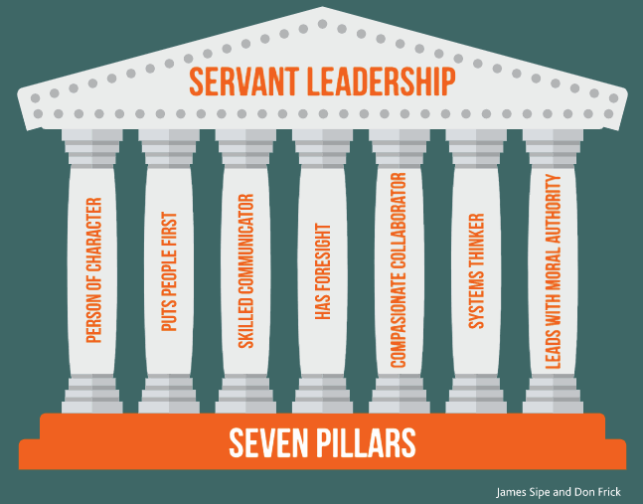
What is Leadership?
Notes:
https://www.greenleaf.org - Get book at https://www.greenleaf.org/products-page/seven-pillars-of-servant-leadership
https://youtu.be/IrCeVwwu0Xc - https://www.slideshare.net/sevenpillarsofservantleadership/seven-pillars-of-servant-leadership-leaderserve-model
- Click to outline “Person of Character” & “Puts People First” as directly connected to our discussions on Empathy/Civic Heart

Slide 12
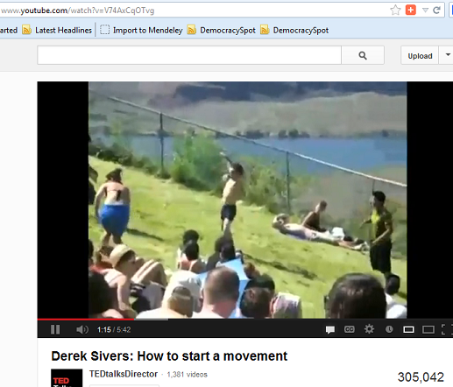
What about the Followers?
Notes:
Here is one of the most engaging and informative YouTube videos I’ve seen on the subject of Leadership – only it looks at the aspect of the Follower. (5:41) http://www.youtube.com/watch?v=V74AxCqOTvg
- How does our growing list of Civic Stuff show up here?

Slide 13
What is civic engagement?
Domain 1 – Civic Heart
Domain 2 – Civic Brain
Domain 3 – Civic Muscle
Notes:
Repeat the 3 domains.

Slide 14

Use JamBoard for your group
Please post first names of your group
on your JamBoard
What should build your Civic Muscle?
Looking for responses around:
Activities you have done
Accomplishments
Things you have built/run
Notes:
Use the JamBoard – each group has its own. Go to http://www.tinyurl.com/C51-CivicMuscle - Use the JamBoard for your Group #. Please put names of your group into a Sticky.
We will take 10 minutes for this.

Slide 15
Report Back
Domain 3 – Civic Muscle
Notes:
2 minutes per group

Slide 16

And the survey said…

Slide 17
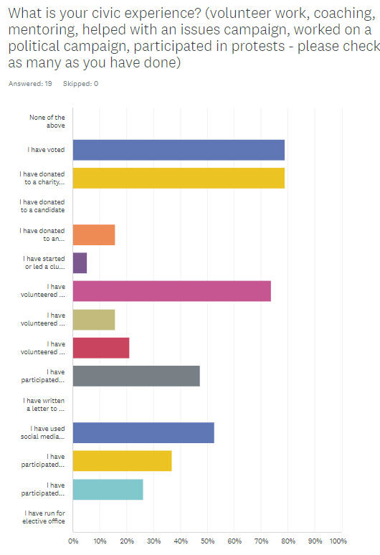
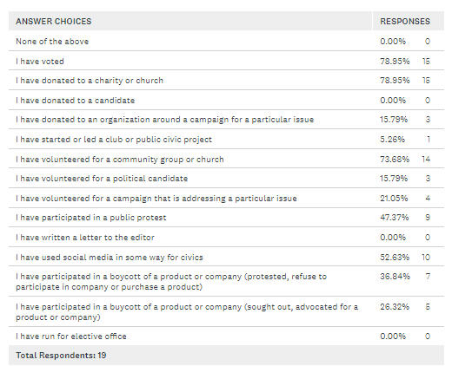
And the survey said…
Notes:
Put PDF into Chat.

Slide 18
Next Class
Notes:
Interns give their presentations!

