Slide 1
Chicago Workers to the Rescue
By steven Phillips Jr Cycle44

Slide 2
Summary
The recession took hold and people were getting layoff by the ten of thousand a month. A group of factory worked that were fired by their boss, were the ones to save that factory. They inspired a nation with what they did. They were fired twice but they formed a workers cooperative.

Slide 3
The Fight
They were fighting for not only their jobs but also for people to get their benefits from these companies that were not giving people their back pay, severance, and time. So of the companies were getting money to help save workers or pay them benefit but they didn't use the money for that. So these workers help with getting people help and justice.

Slide 4
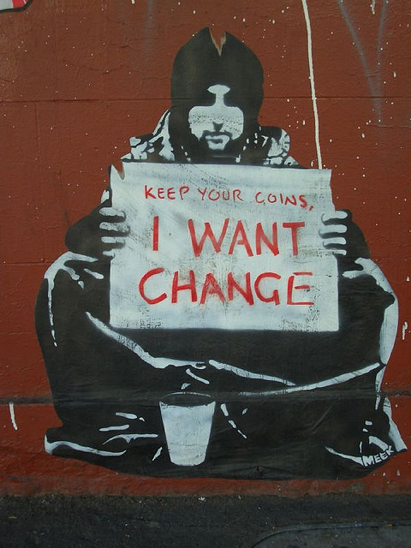


Slide 5
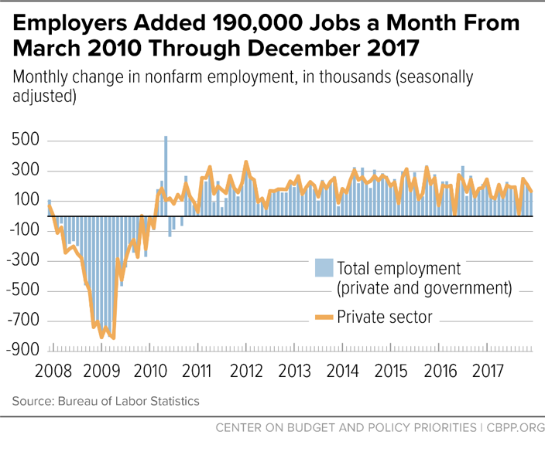

Slide 6
Solution
It should be a work law that say if a recession is to happen then the workers should get whatever is own to them.

